Slide 1
Project
Dr. S.RadhaKrishnan Team
The
By-
Ayesha
Rishvanth
Surya. P
Jignesh
Veeraju

Slide 2






Content
Oracle
Mongo
SSMS
Cloudera Hive
Talend
Tableau

Slide 3
Extract
Transform
Load
Data :-
Retail price.csv,
Online_Store_customer_data.csv
Extracted data will be used for transforming data
Oracle, Mongo, SSMS, Cloudera-Hive
Using Talend to extract the data
we load the data into different databases
Data :-
Retail price.csv,
Online_Store_customer_data.csv
Using Tableau to represent the data in graphical format
Data will be represented in Graphs, Pie charts, Longitude and latitude etc.,

Slide 4
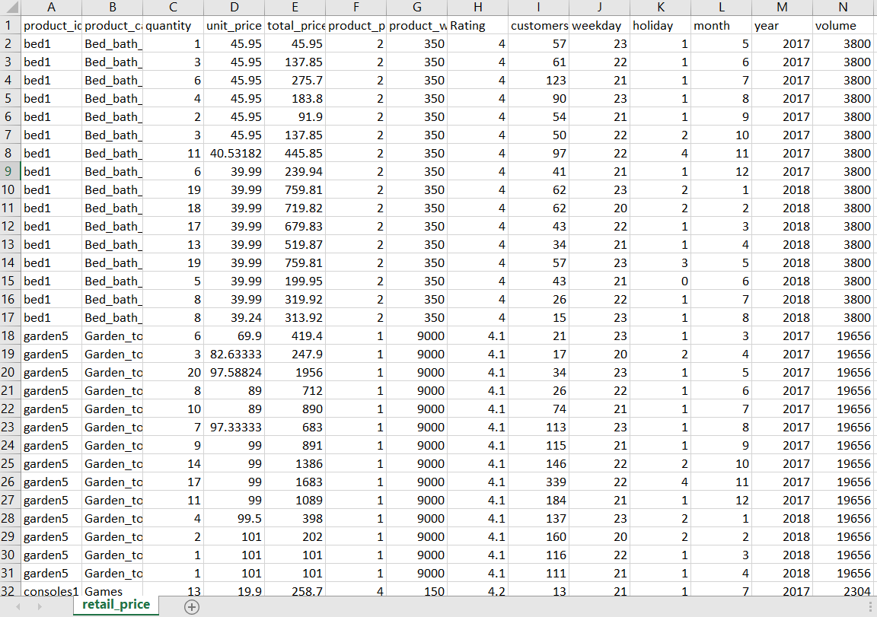
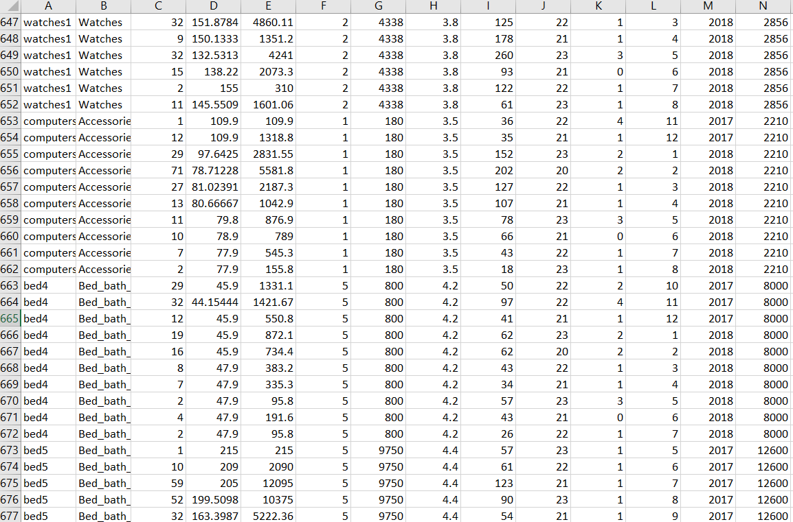
Data - Retail_price.csv

Slide 5
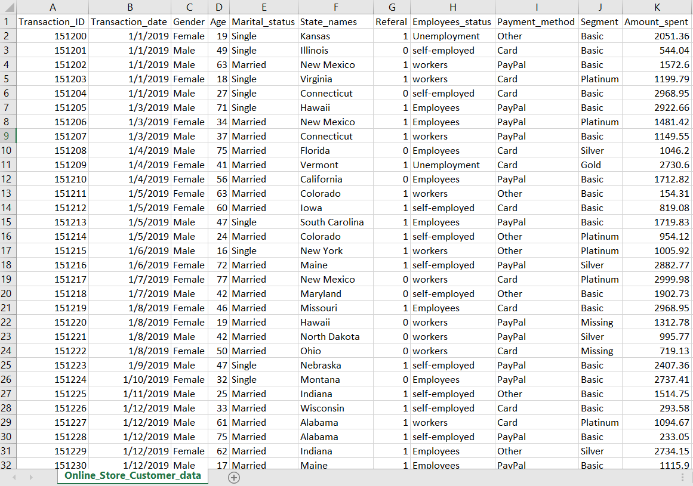
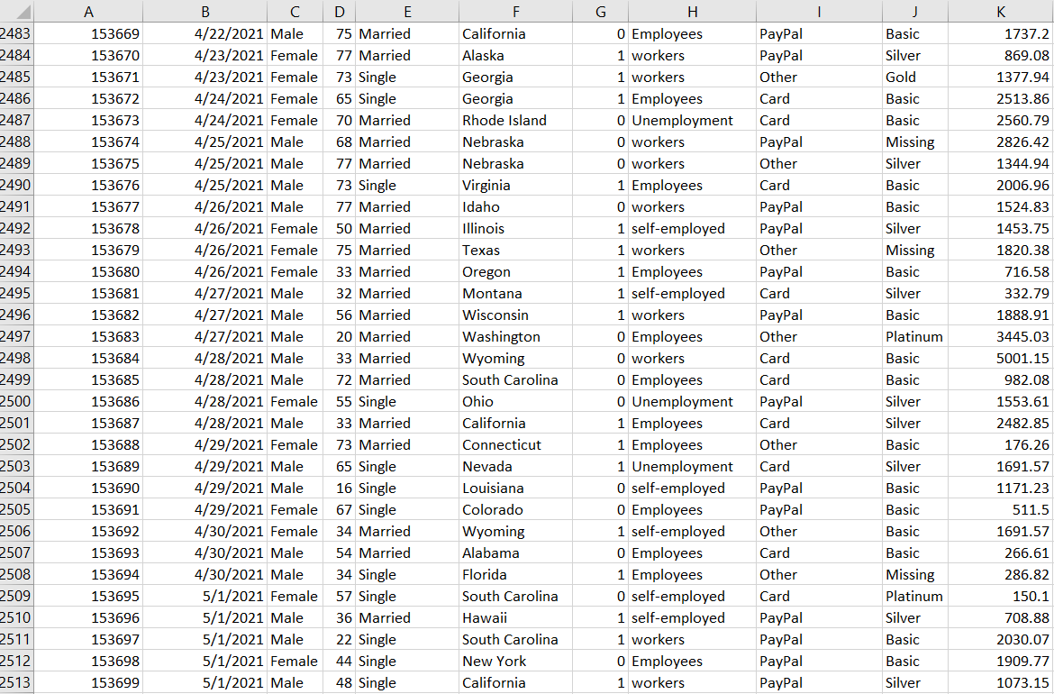
Data - Online_store_customer_data.csv

Slide 6
Talend
Data Integration tool

Slide 7
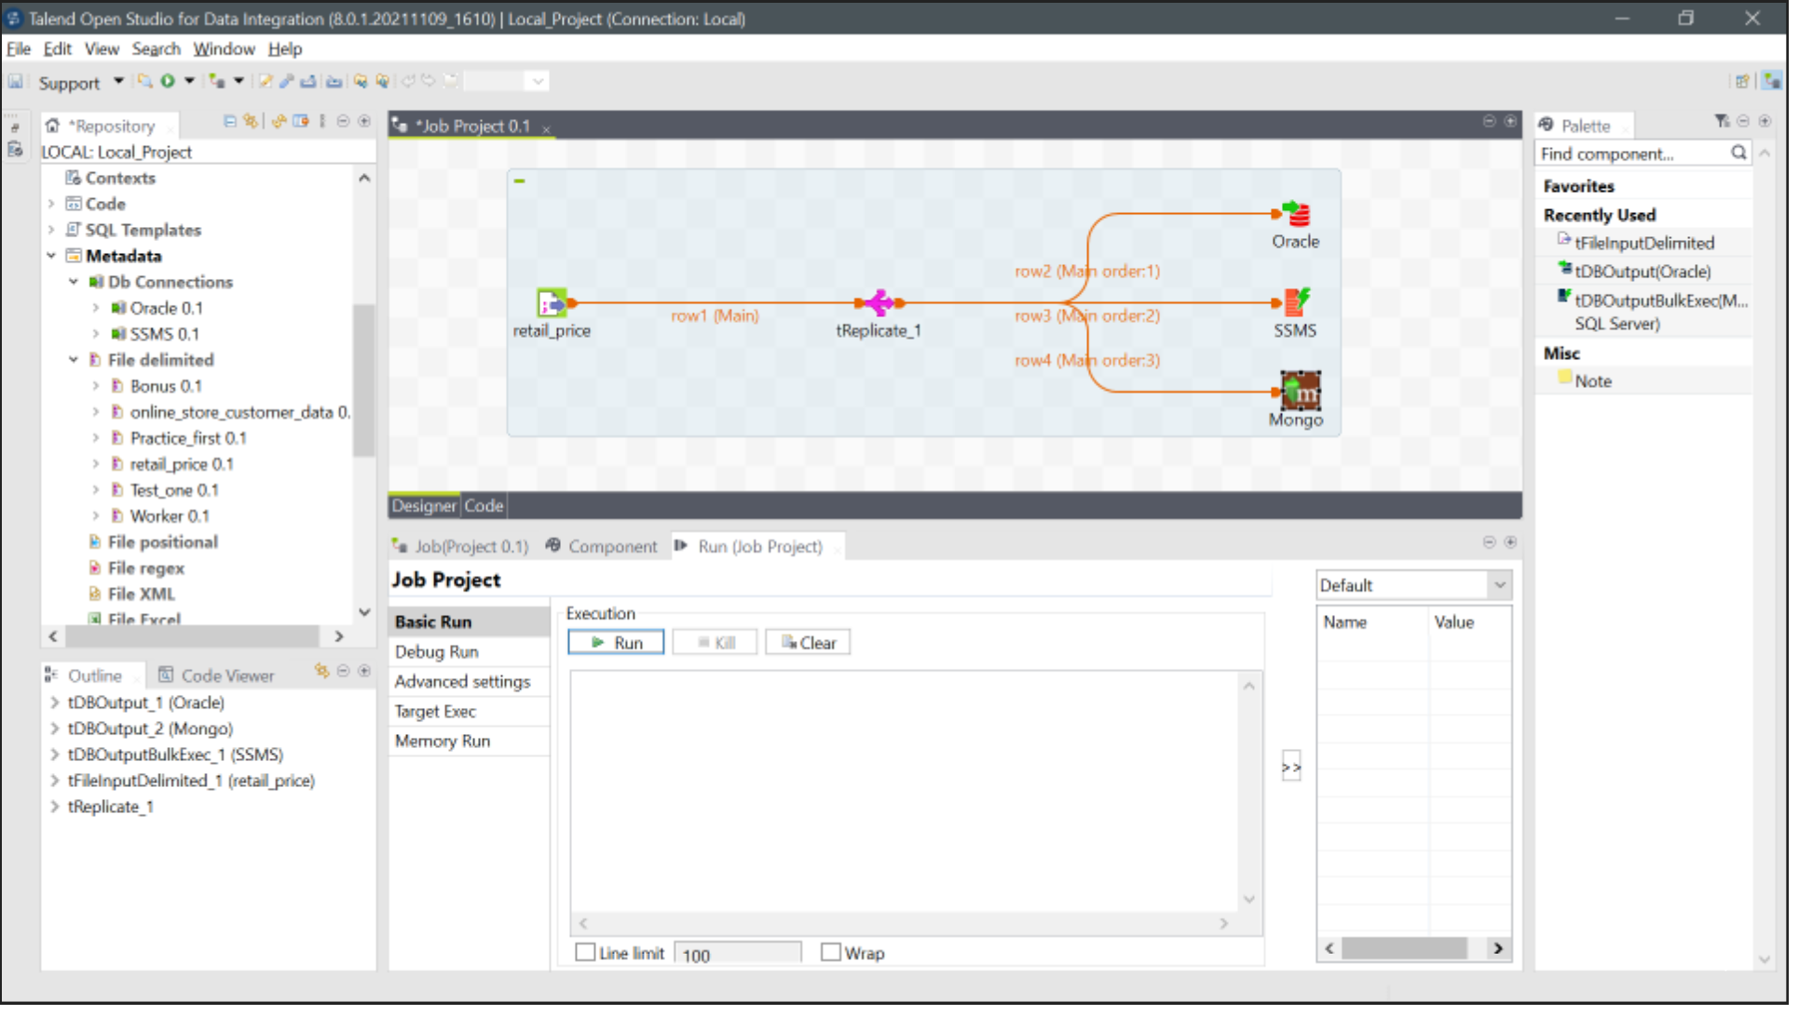
Retail_price

Slide 8
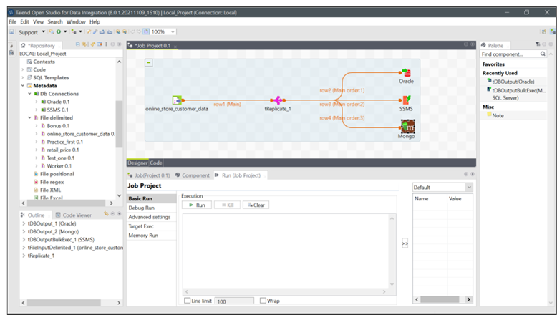
Online_store_customer_data

Slide 9

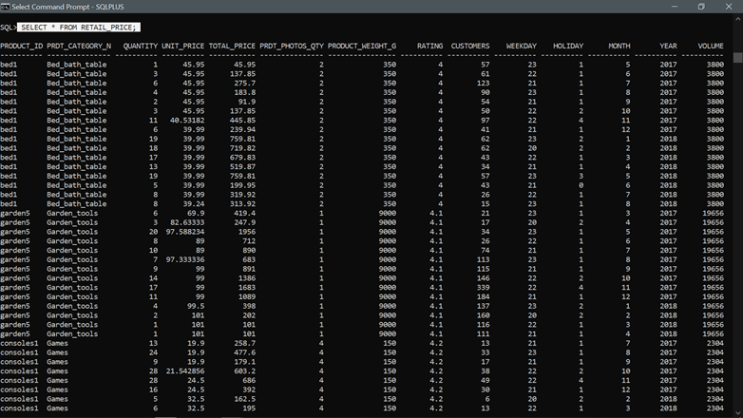
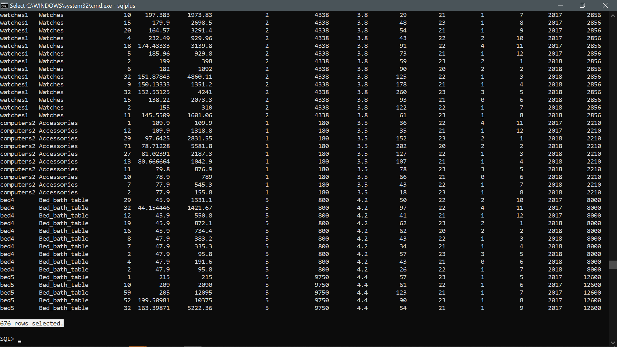
SQL
SELECT * FROM RETAIL_PRICE;

Slide 10
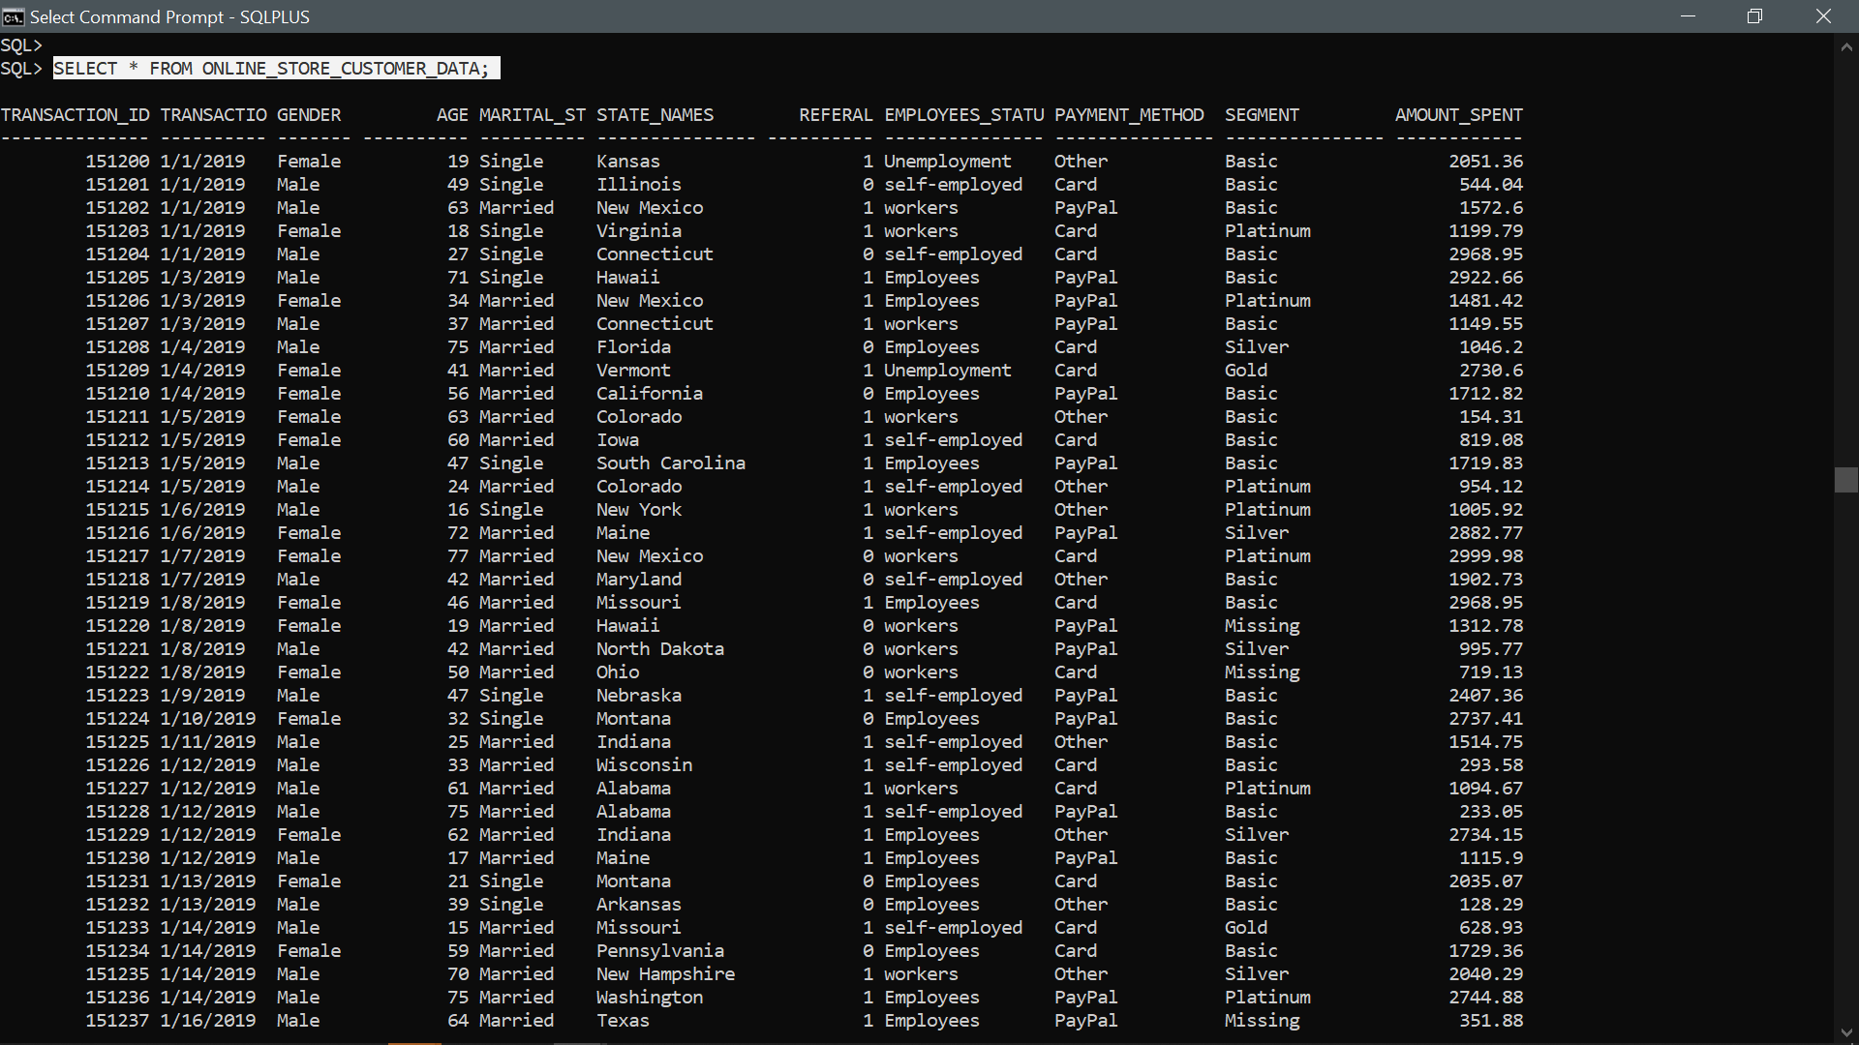
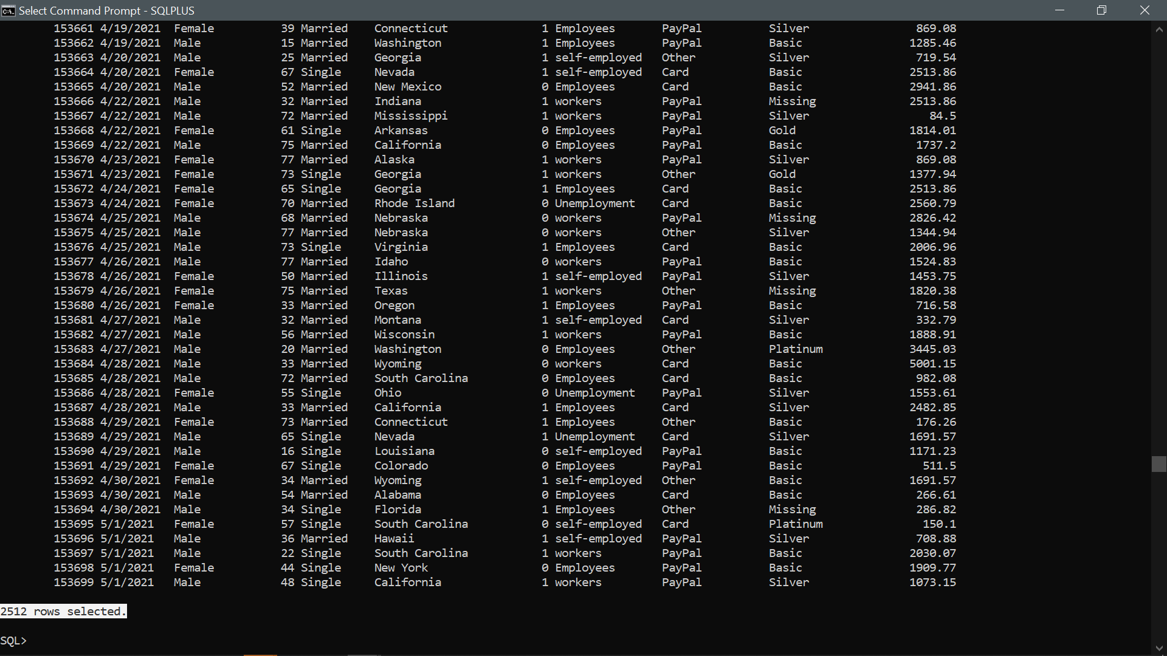
SELECT * FROM ONLINE_STORE_CUSTOMER_DATA;

Slide 11
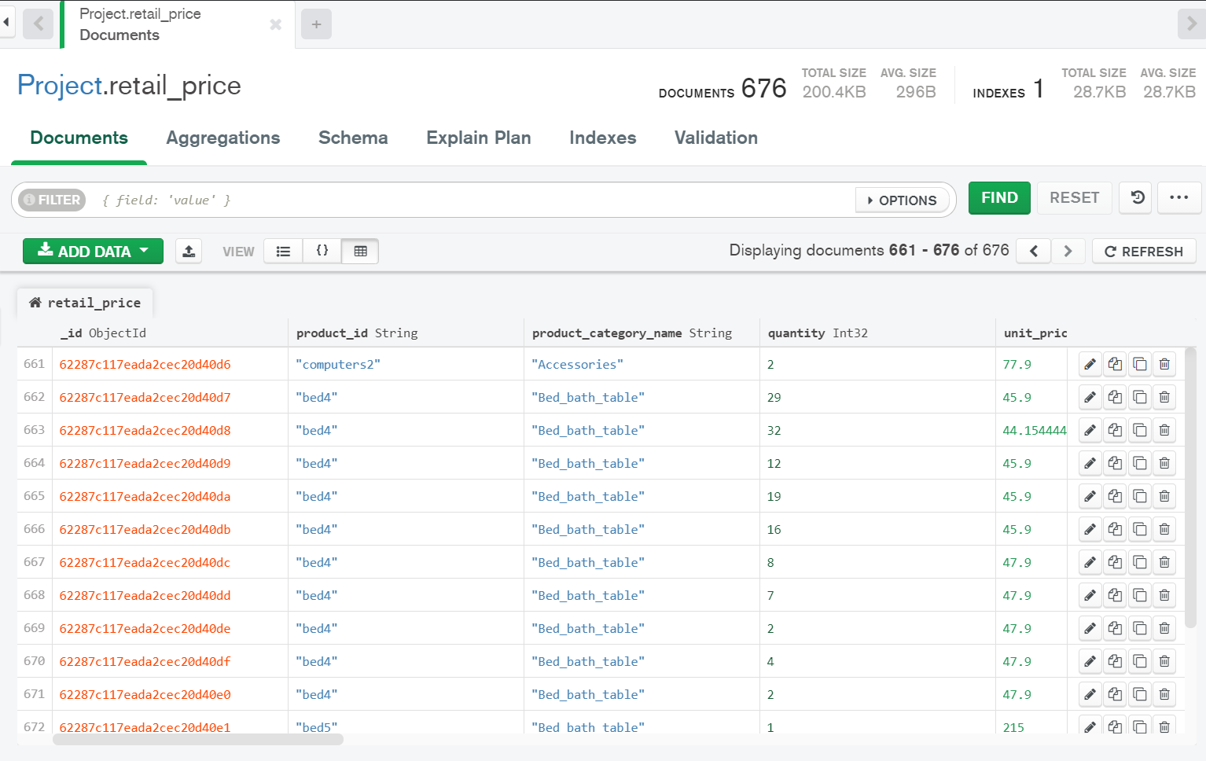
db. retail_price.find()
Mongo db

Slide 12
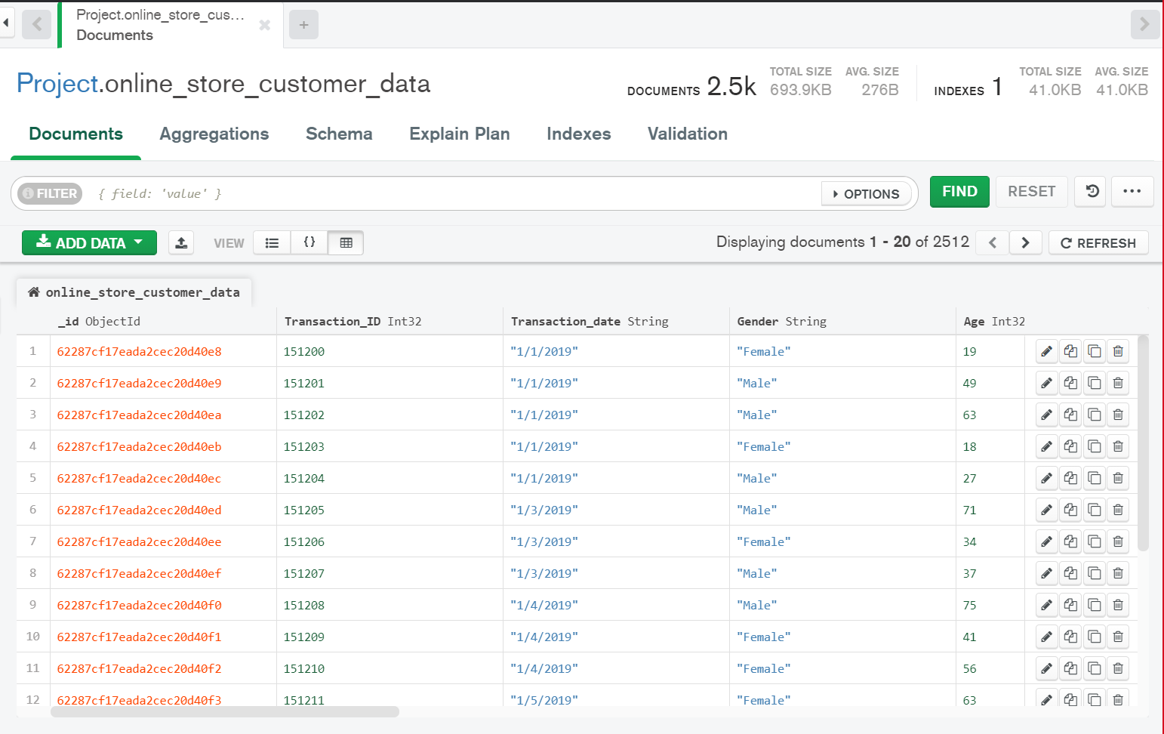
db. online_store_customer_data.find()

Slide 13
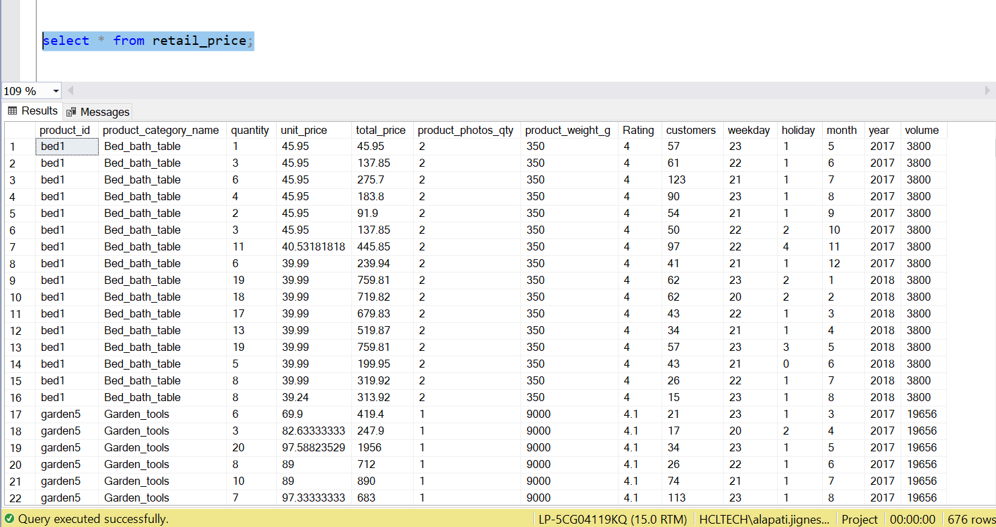
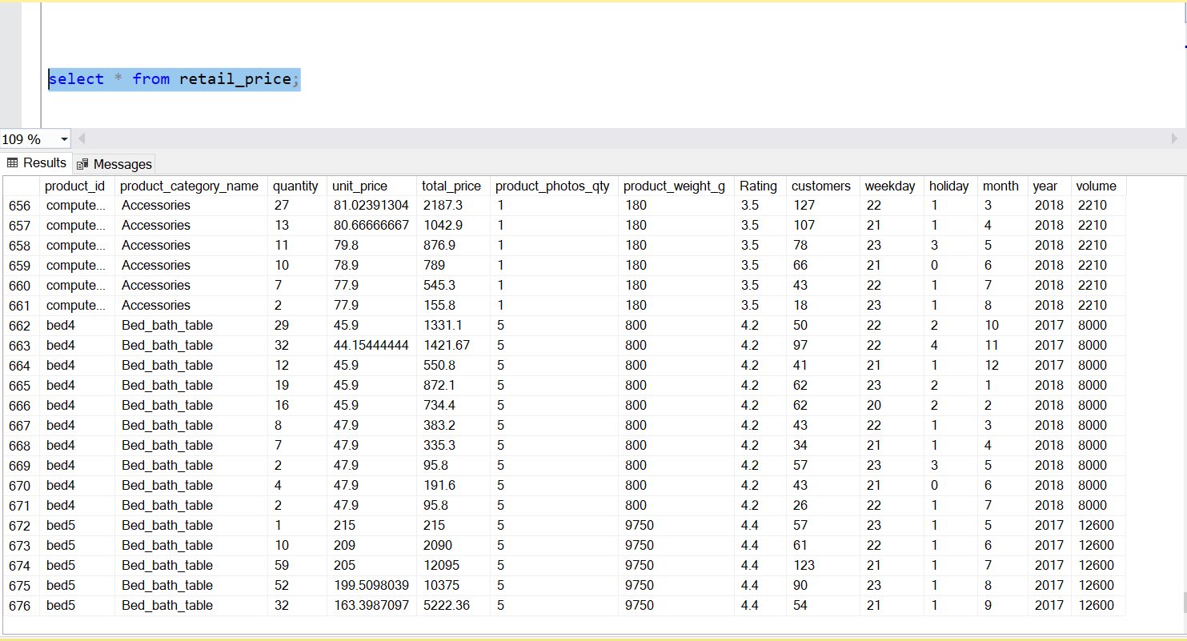
SSMS
select * from Retail_price;

Slide 14
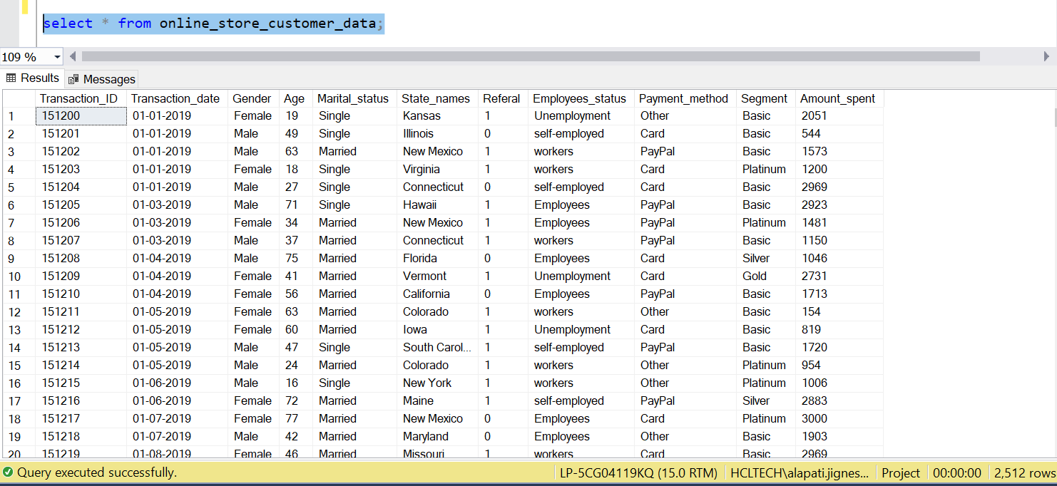
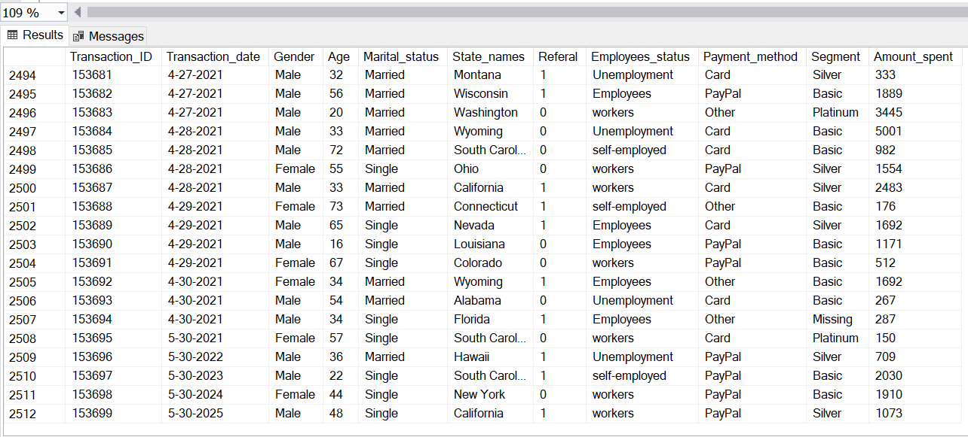
select * from Online_store_customer_data;

Slide 15
Tableau
Business Intelligence Tool

Slide 16
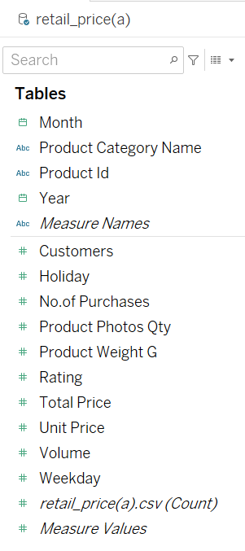

Retail Price

Slide 17
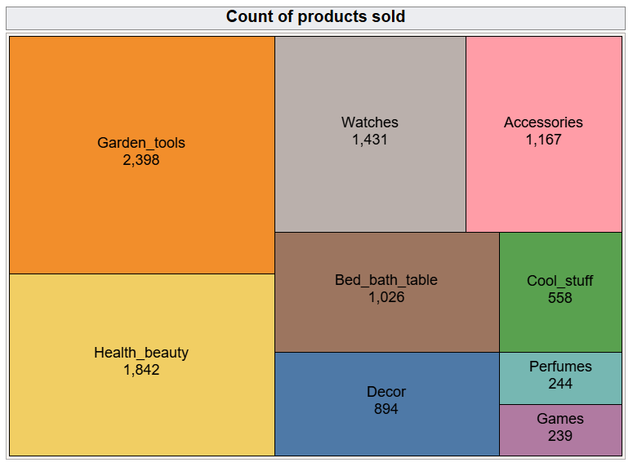
Report – 1

Slide 18


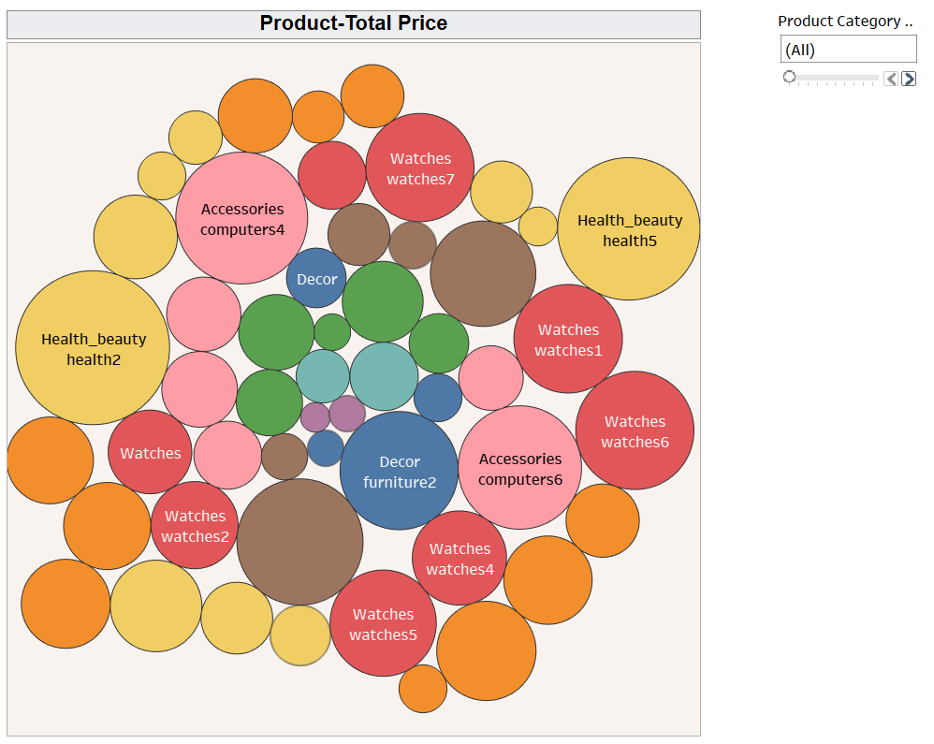







Report – 2

Slide 19


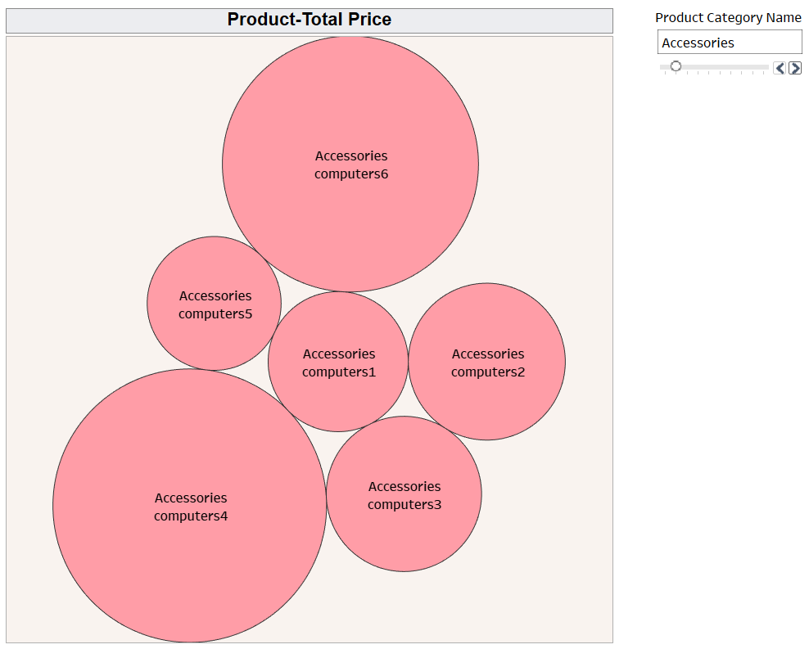
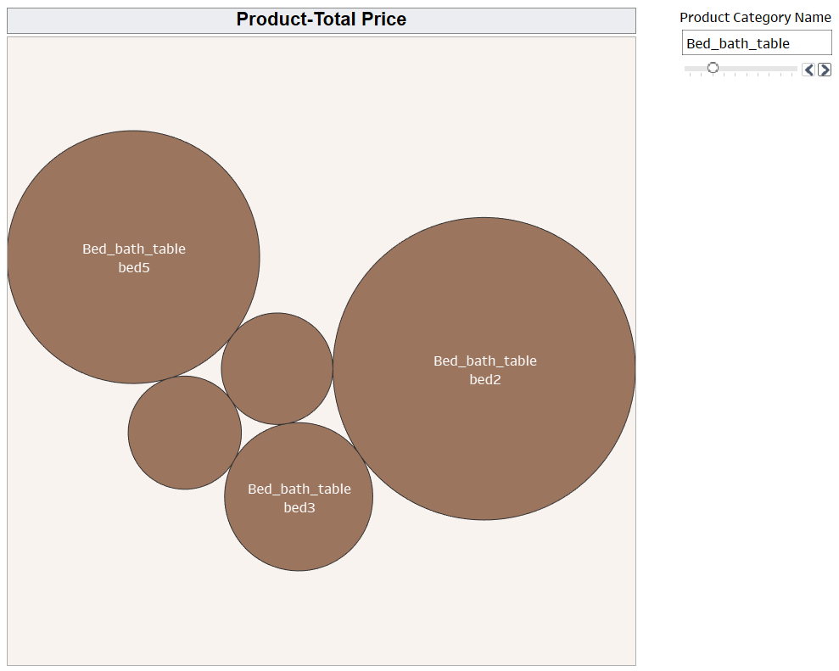
Accessories
Bed bath table
bed1
bed2

Slide 20


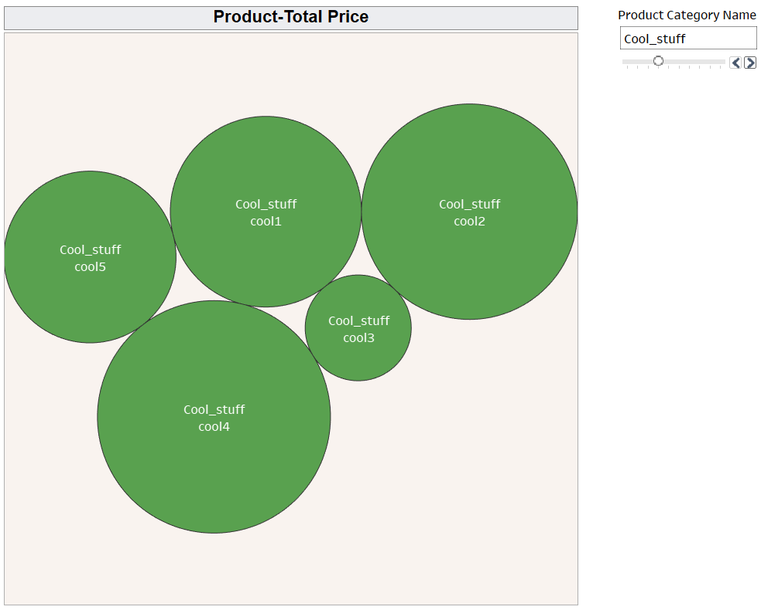
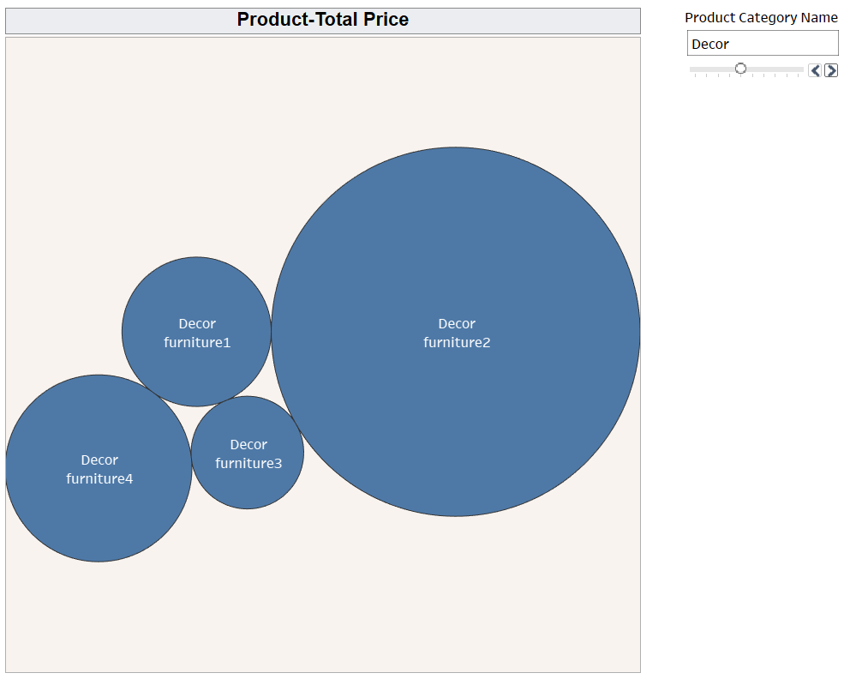
Cool stuff
Decor

Slide 21


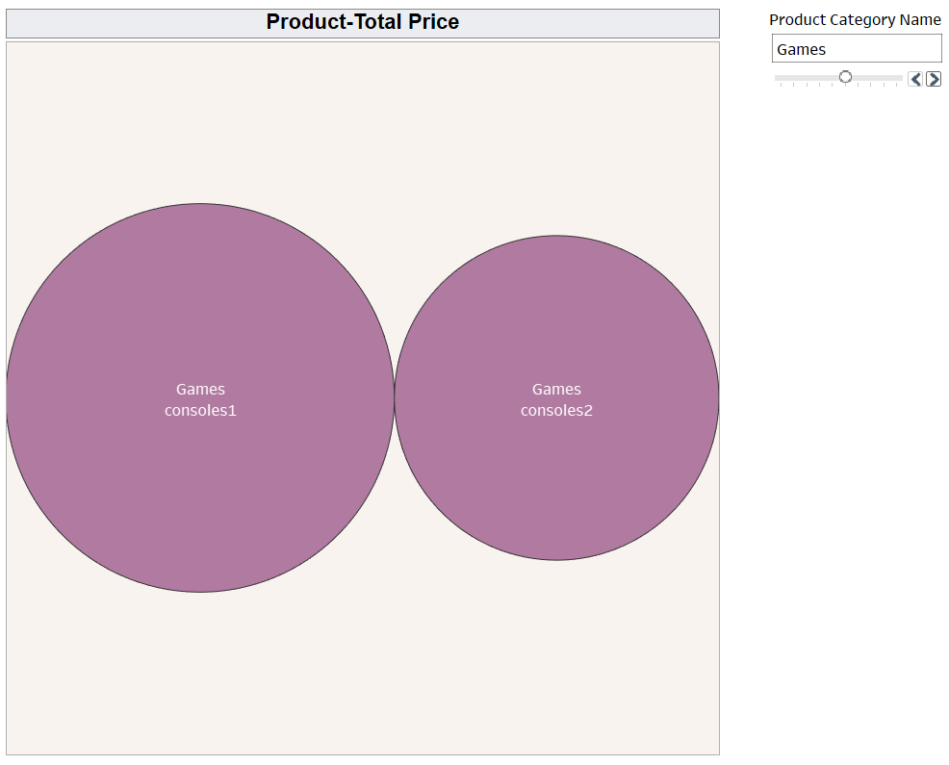
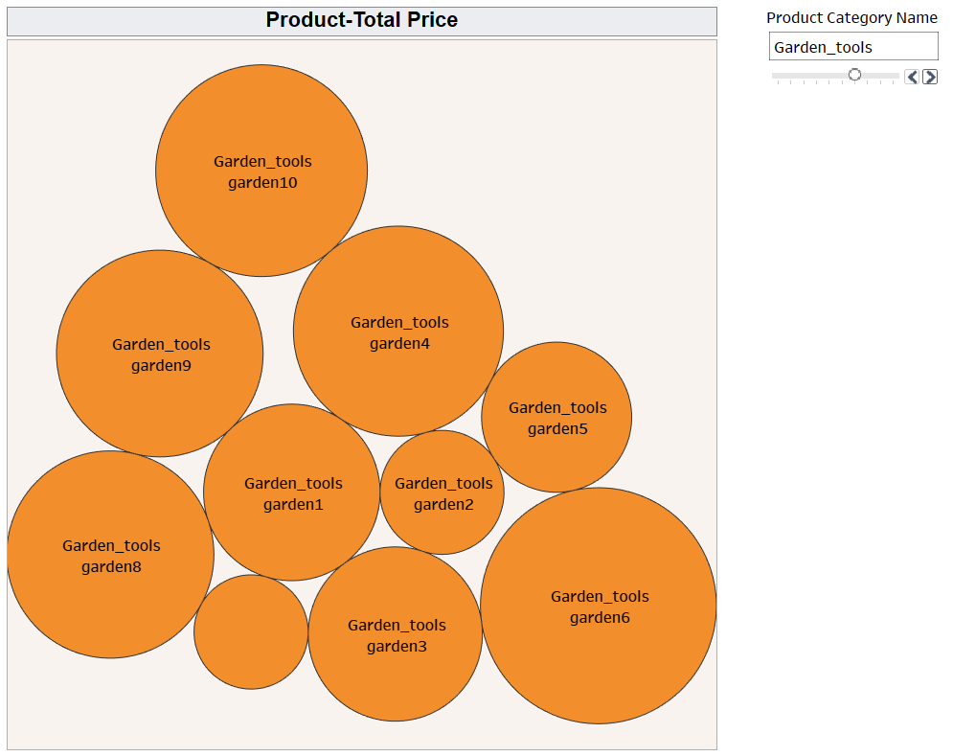
Games
Garden tools
garden7

Slide 22


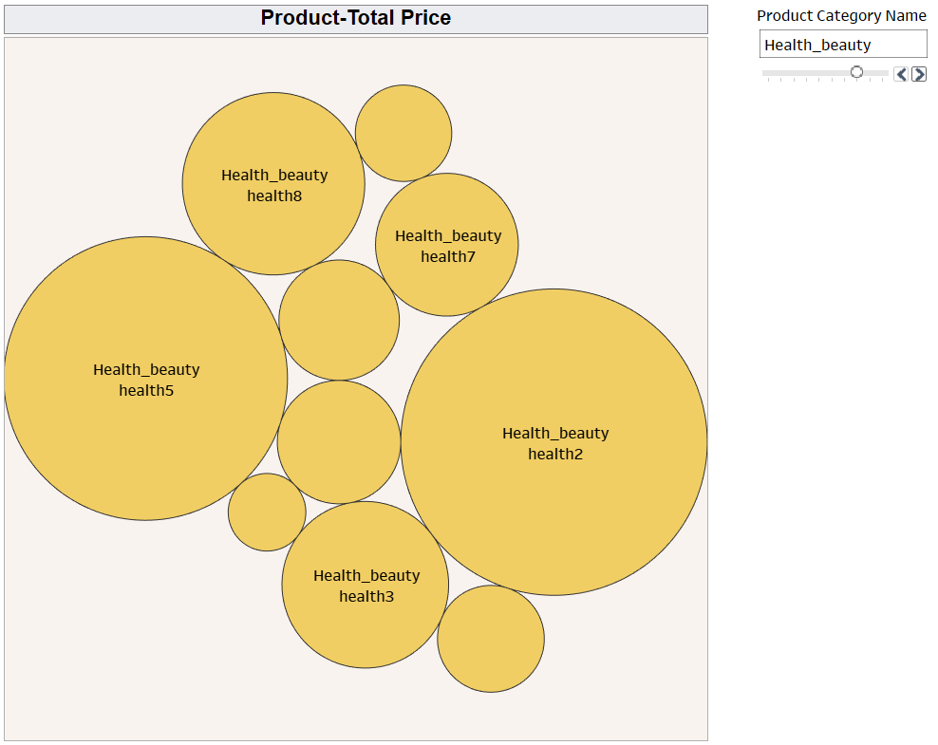
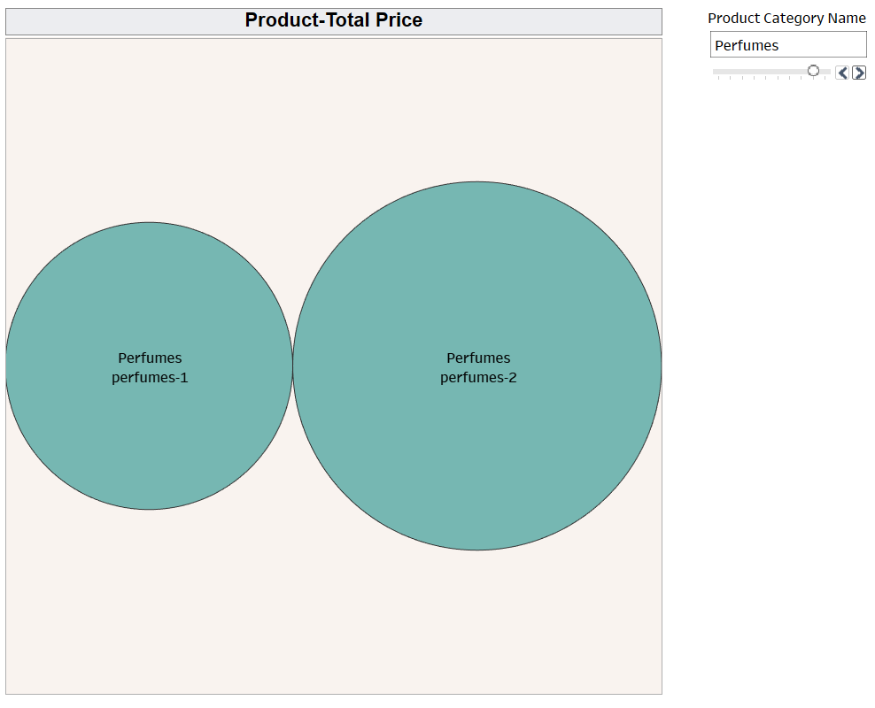
Perfumes
Health beauty
health10
health9
health1
Health
4
health6

Slide 23

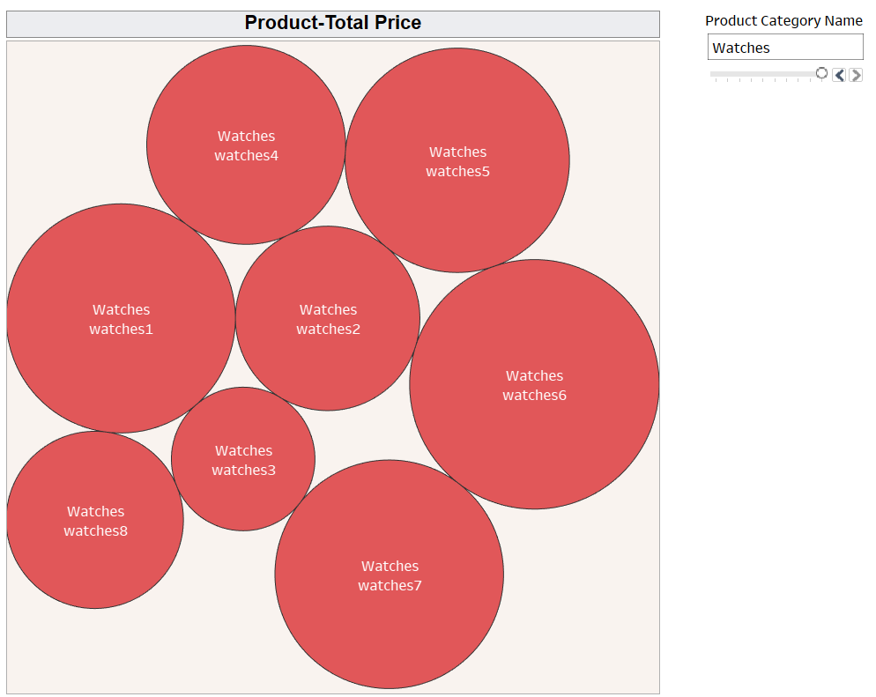
Watches

Slide 24
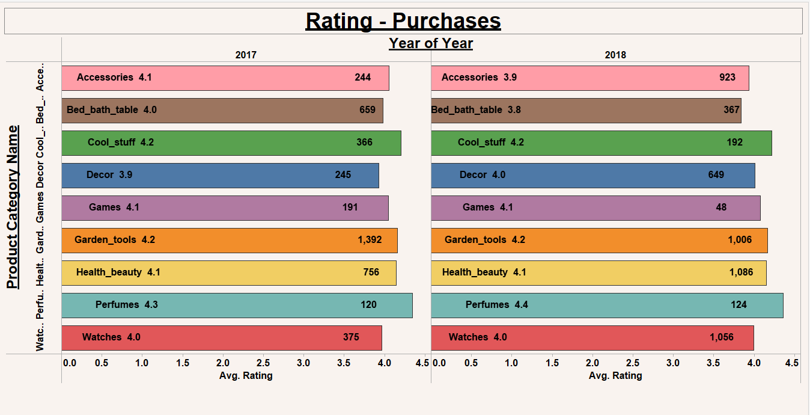
Report – 3

Slide 25
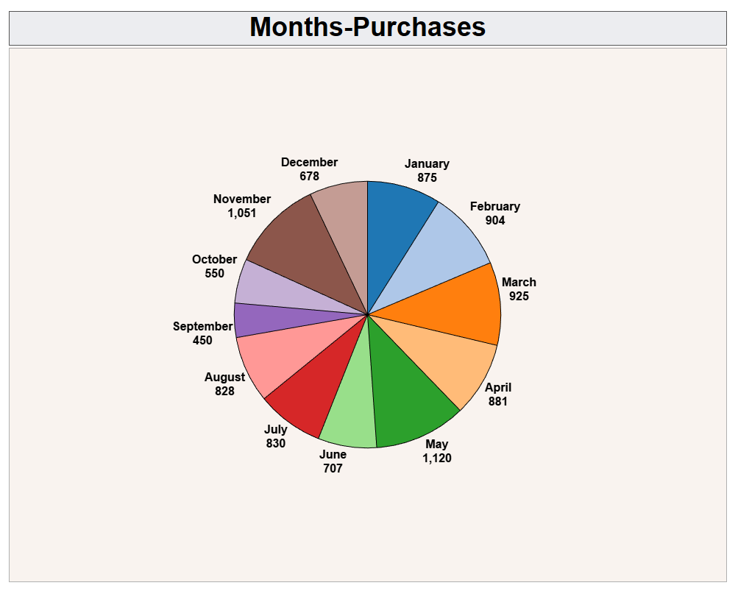
Report – 4

Slide 26
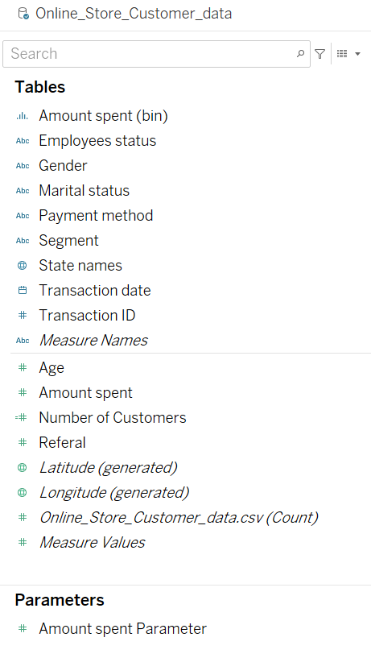
Online Store Customer Data

Slide 27
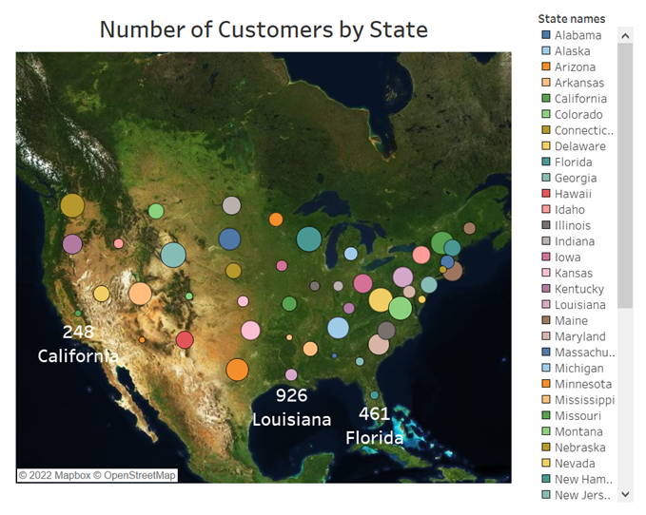
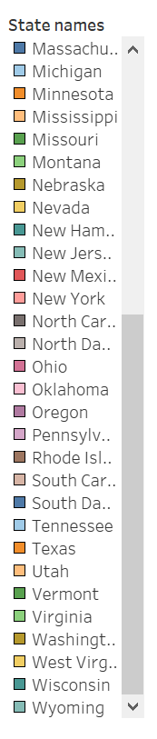
Report – 1

Slide 28
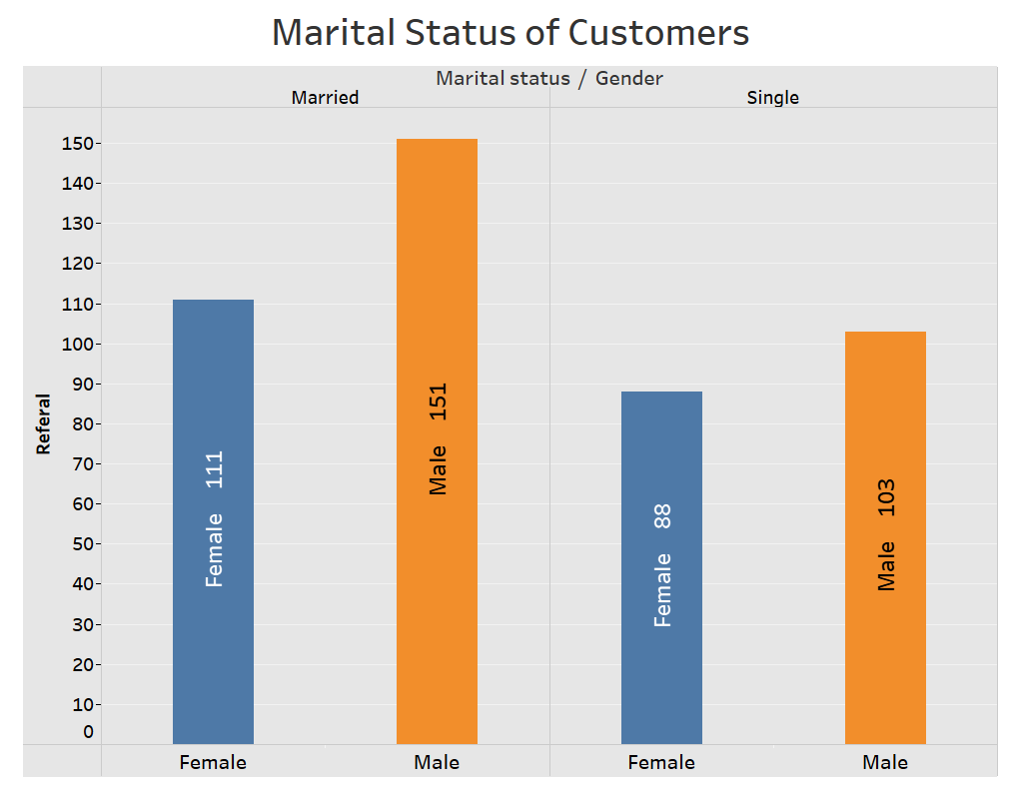
Report – 2

Slide 29
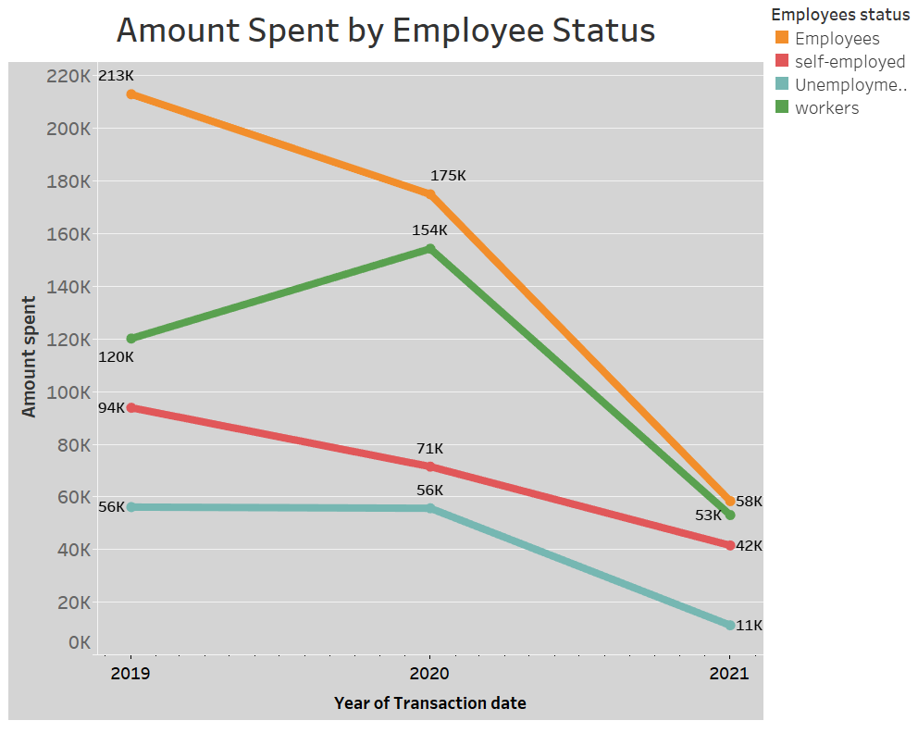
Report – 3

Slide 30

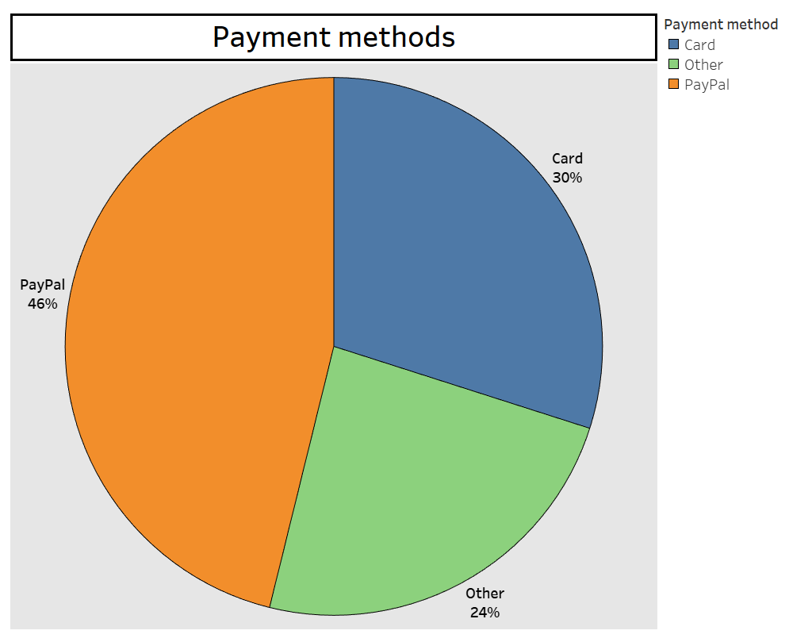
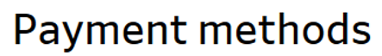
Report – 4

Slide 31
Big Data
Cloudera VM

Slide 32
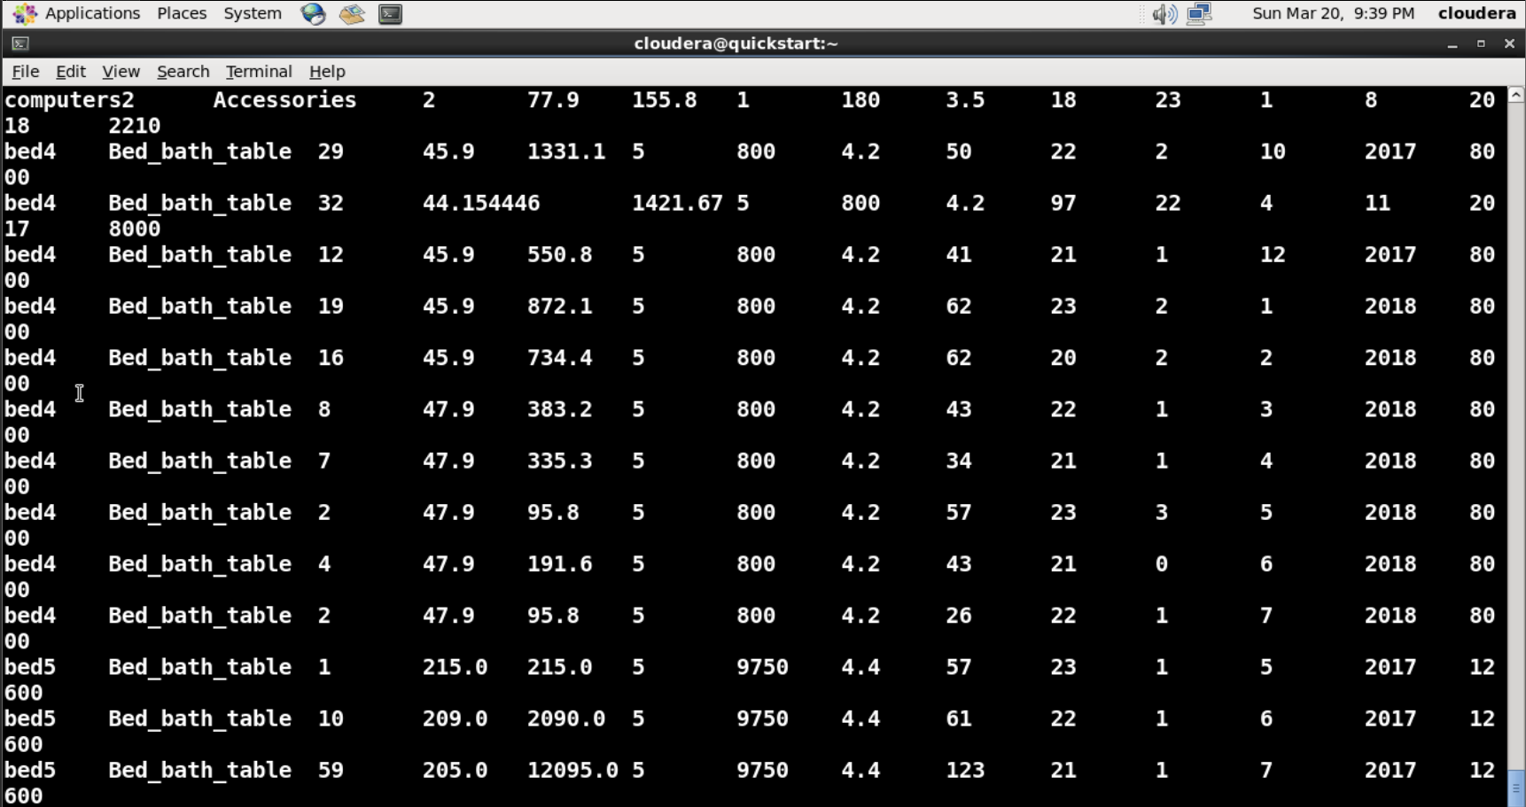
select * from Retail_price
Hive

Slide 33
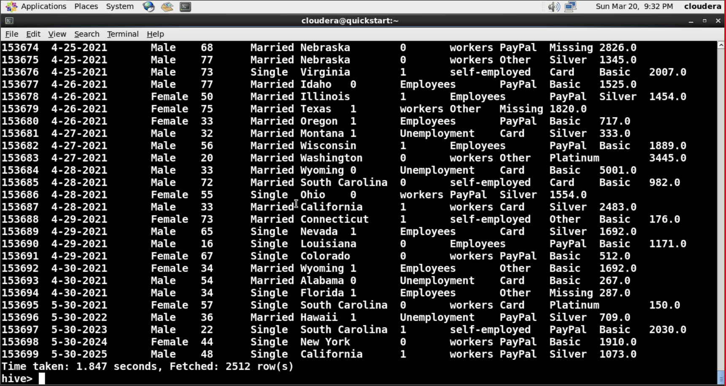
select * from Online_store_customer_data

Slide 34


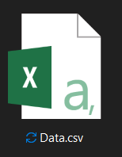



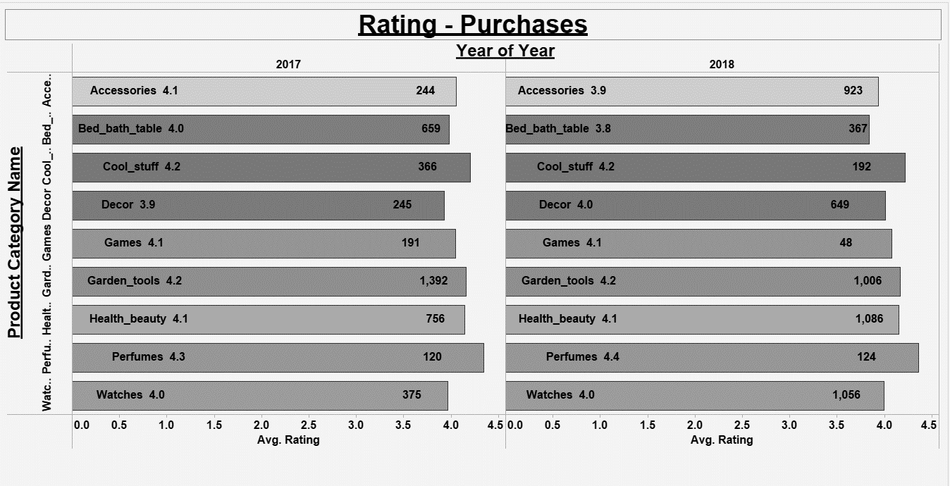
Summary

Slide 35
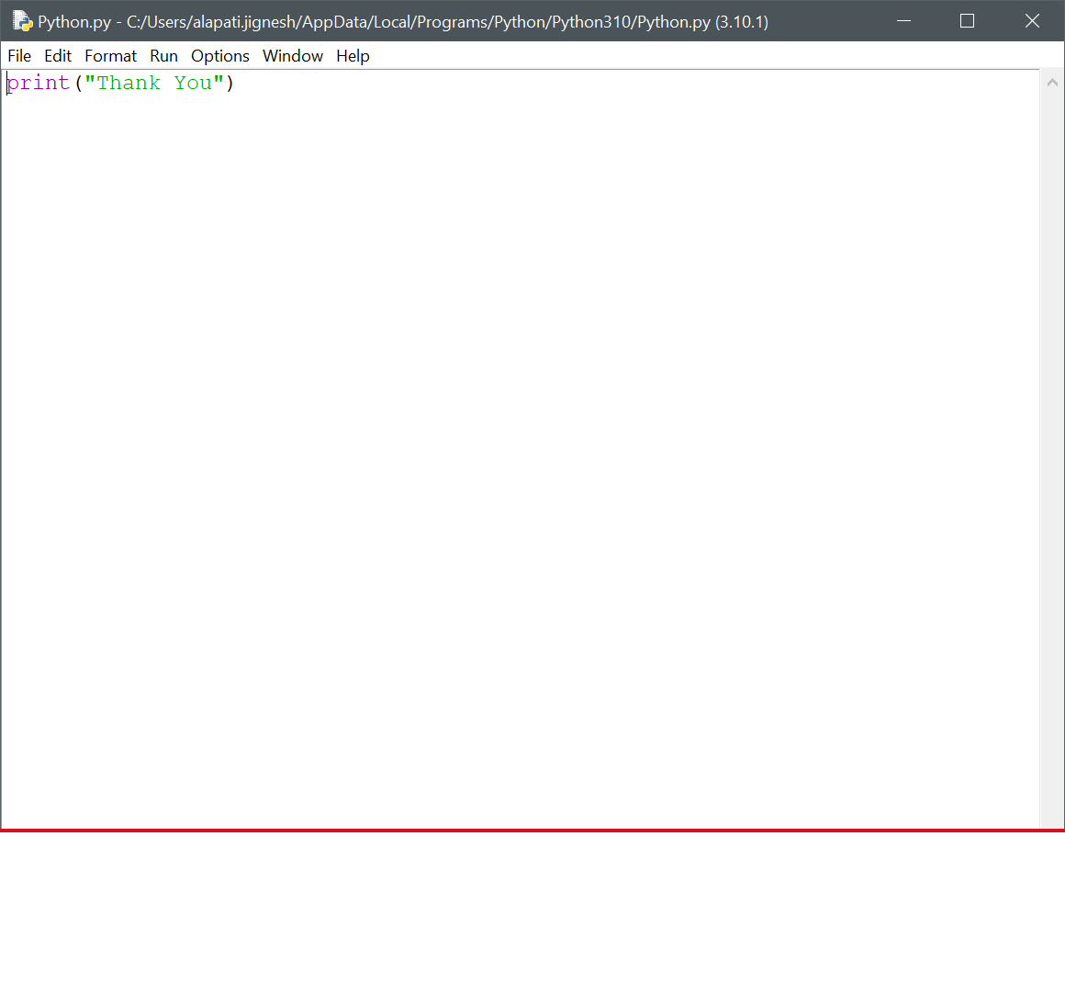

Thank You

